Slide 1
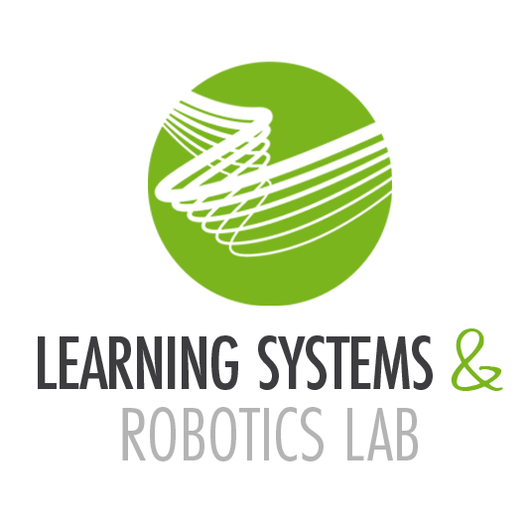

Autonomous Drone Racing Optimization vs. RL
Autonomous Drone Racing - Final Presentation
17.07.2024
Tim Lindenau

Slide 2
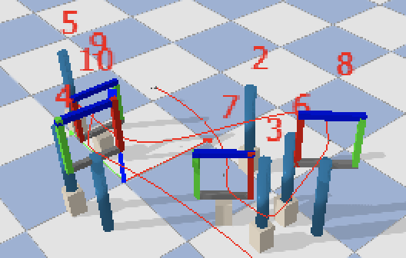
The Challenge – Autonomous Drone Racing In Uncertain Environments
Goal: Developing high level controller to safely slalom through a set of gates in the shortest time possible
Challenge: Uncertainties in the position of gates and obstacles require within-fight updates as true gate position only becomes available shortly before passing
Notes:
I want to start this presentation with a short recap of the task of this lab. The general goal was to solve autonomous drone racing in an uncertain environment, where the position of gates and obstacles is only known up to nominal values and shifted by disturbances during runtime.
The key to be successful in this environment is that a controller must be be able to react to updated gate information delivered within flight and re-plan their solution accordingly.

Slide 3
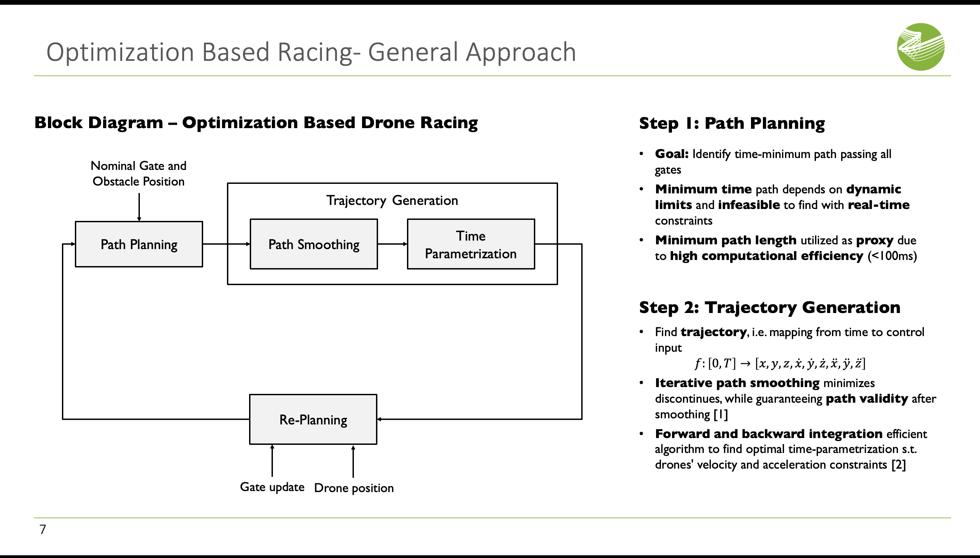
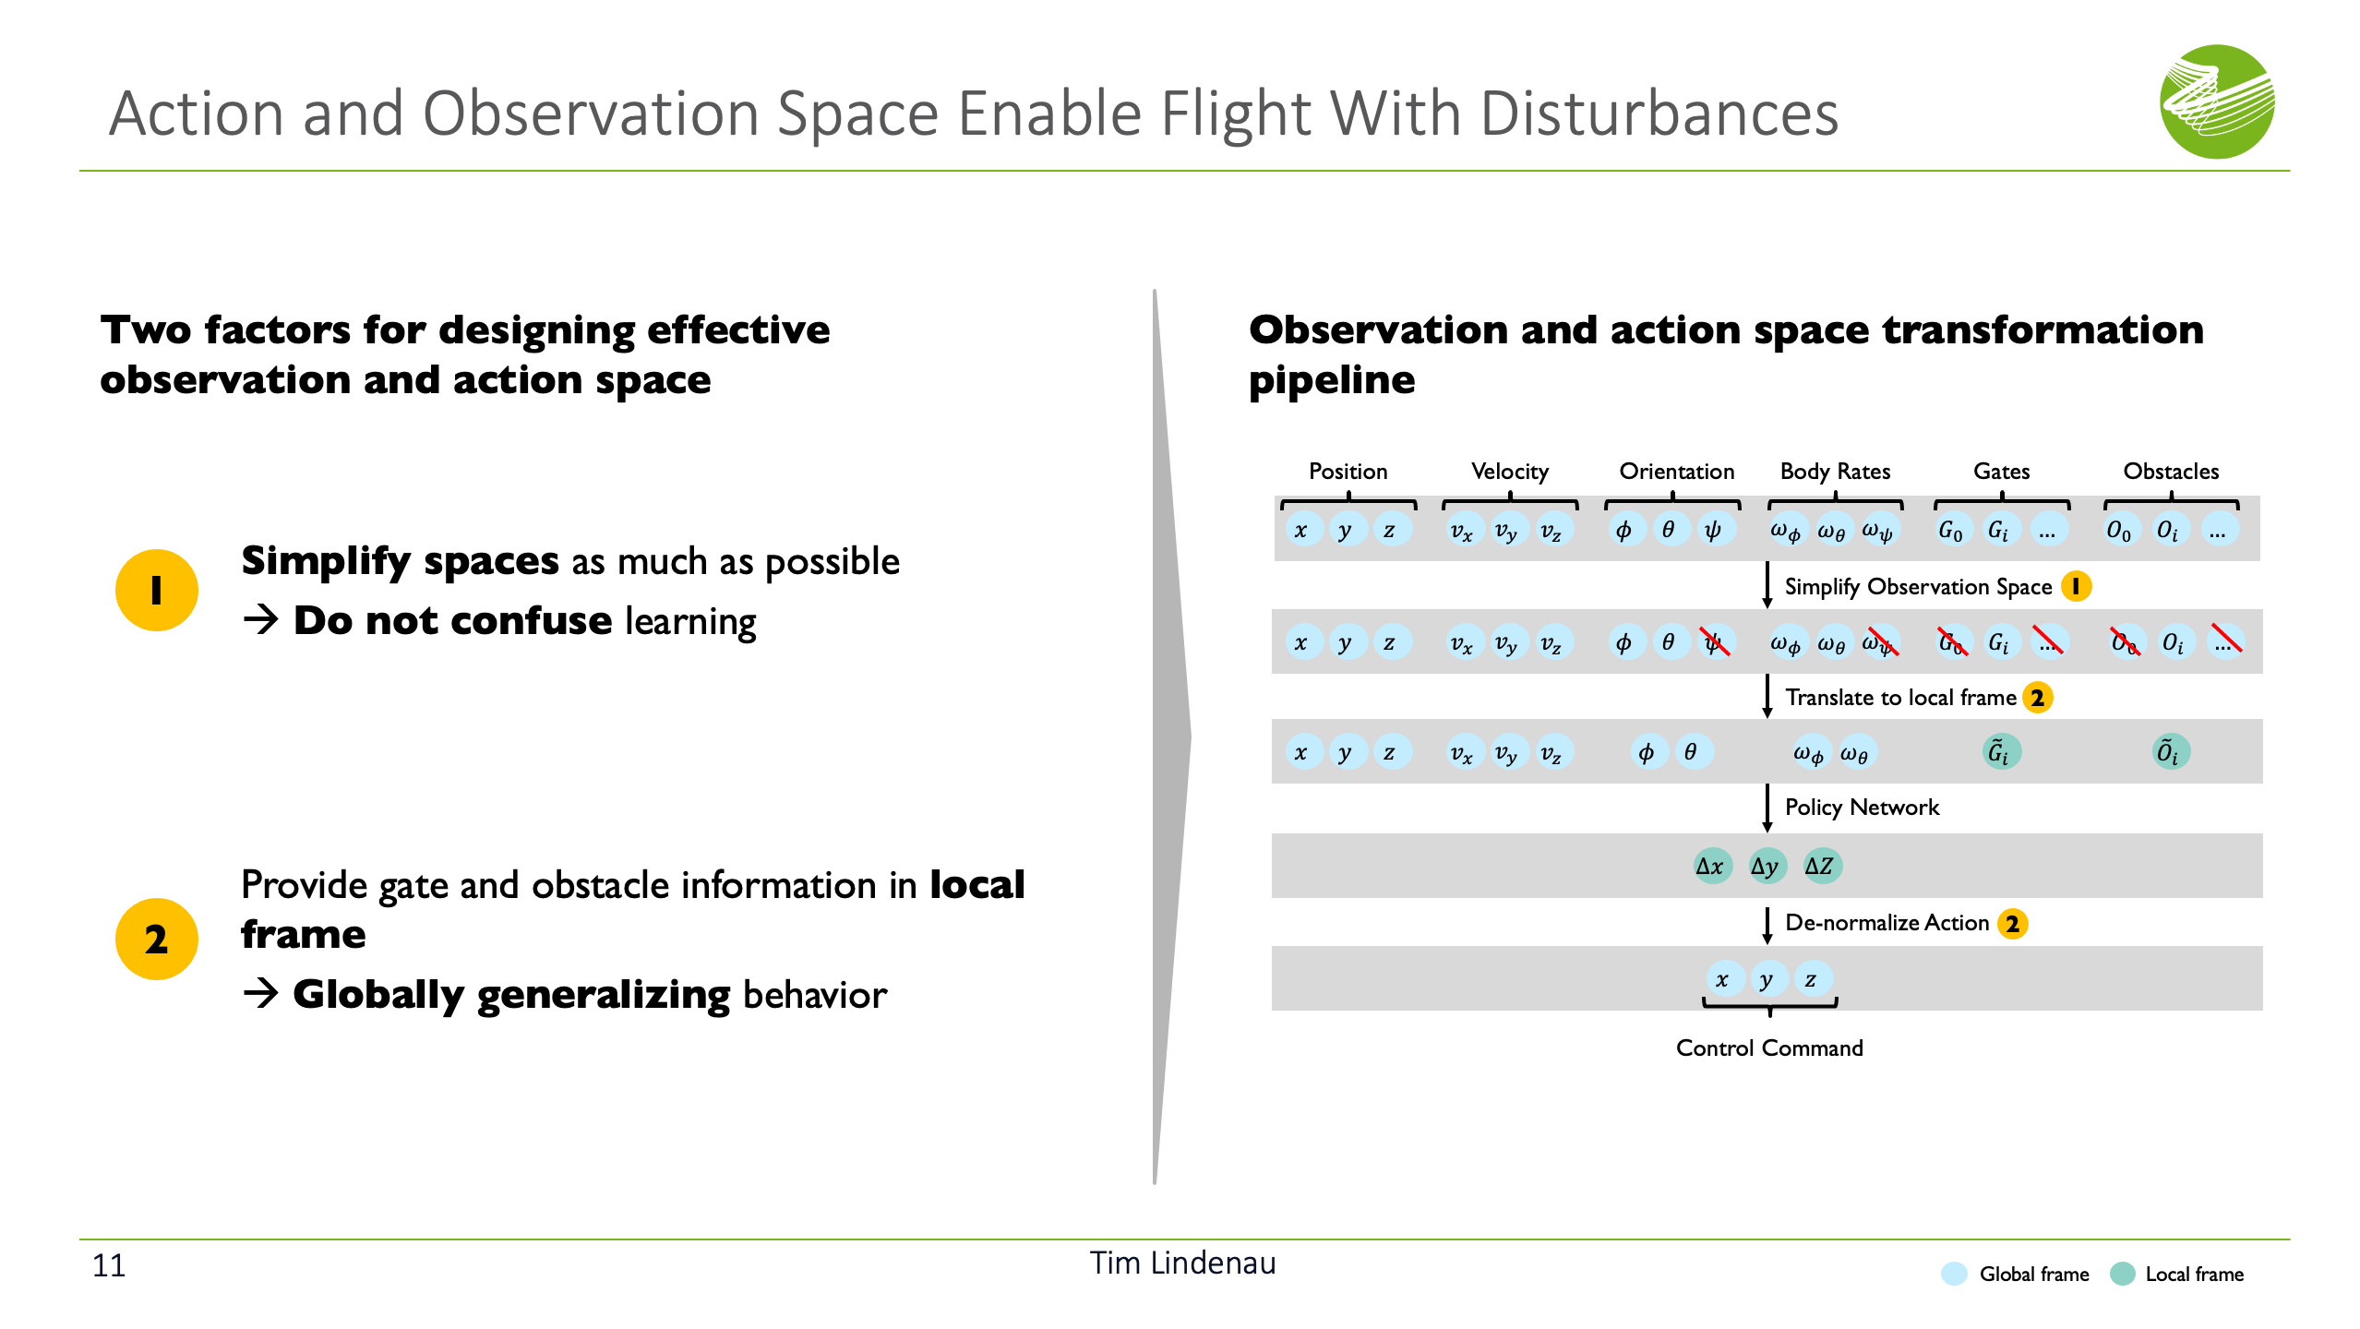
Two Possible Approaches: Optimization and Reinforcement Learning
Approach 1: Optimization
Approach 2: Reinforcement Learning
Notes:
I solved the given challenge in two ways, using traditional path-planning and using reinforcement learning. In the next minutes I want to present the key ideas behind both approaches

Slide 4
Two Possible Approaches: Optimization and Reinforcement Learning
Approach 1: Optimization
Approach 2: Reinforcement Learning
Notes:
Lets start with the optimization approach

Slide 5

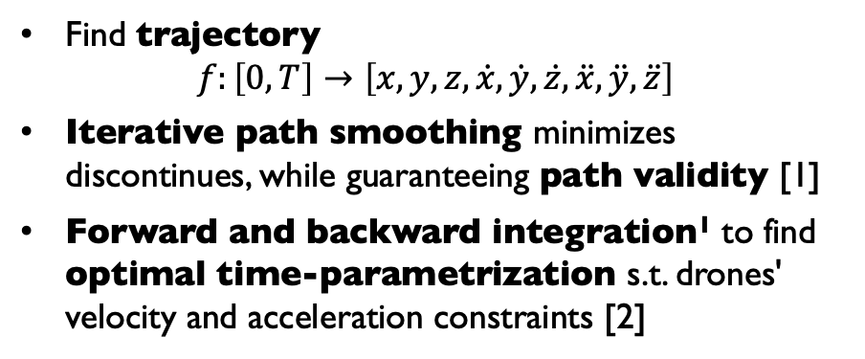
Optimization Based Racing- General Approach
Step 1: Path planning
Block diagram – Optimization based drone racing
Goal: Identify time-minimum path
Minimum time path depends on dynamics and computationally expensive to find
Minimum path length utilized as proxy due to high computational efficiency (<100ms)
Nominal Gate and Obstacle Position
Trajectory Generation
Path Planning
Path Smoothing
Time Parametrization
Step 2: Trajectory generation
Find trajectory $f:\left[0,T\right]→\left[x,y,z,\dot{x}, \dot{y},\dot{z}, \ddot{x},\ddot{y},\ddot{z}\right]$
Iterative path smoothing minimizes discontinues, while guaranteeing path validity [1]
Forward and backward integration¹ to find optimal time-parametrization s.t. drones' velocity and acceleration constraints [2]
Re-Planning
Step 3: Re-planning
Re-plan within flight to adapt to updates
Currently only updating gates not obstacles
Gate Update
Drone Position
¹ See https://www.youtube.com/watch?v=WR2oPxJi-H0&t=115s for introduction
Notes:
The optimization-approach is based on the commonly used 2 stage pipeline of path-planning and trajectory generation, which I extended with an extra re-planning component as shown here on the left
The first stage is path planning where the goal is to identify the time minimum racing path. Since this minimum time path is dependent on the given drone dynamics, solving for it is computationally expensive and not possible in our time-constrained setup which must allow for re-computations. Therefore, instead of the fastest path the algorithm searches for the shortest path which is much more efficient and can be solved in under 100ms using for example the Fast-Marching Tree algorithm.
In the second trajectory generation stage the goal is now to find a continuous mapping from time to control input passing the path as fast as possible. Initially I experimented with the commonly used minimum-snap approach. While this worked well in previous works it did not work for me. Rather it often caused collisions since the fitted minimum snap trajectory commonly overshoot the collision free straight-line segments of the original path, which was an issue especially at sharp turns as they are common when re-planning.
To overcome this issue, I ended up with a second approach that begins with first smoothing the pre-planned path to remove any discontinuities that would make it hard for the drone to follow at high speeds. However, instead of the common way of using splines or polynomials again potentially diverging from the original path and causing collisions, I used an iterative smoothing approach that can guarantee path validity even after smoothing. Then in the second step the trajectory is generated by finding an optimal time-parametrization and belonging control inputs to follow the smoothed the path as fast as possible while accounting for the drone's velocity and acceleration limits subject to the shape of the path. The time parametrization algorithm is based on a process called forward and backward integration, however due to time constraints I do not have time to go into the details now.
Finally, the third stage is within flight re-planning to update the trajectory whenever new information becomes available. Due to limited time, the algorithm currently only reacts to gate changes, which I want to talk about on the next slide.
3:15

Slide 6
Challenges of Within Flight Re-Planning
Re-planning: The challenge
Non-blocking implementation and start-point offset enable re-planning without loss of control
Computational efficient trajectory generation pipeline, enables computation times of around 100ms
1
Non-blocking trajectory generation
1
Trajectory computation in extra thread prevents blocking of main control loop
Controller continues based on previous trajectory until re-planning completed
2
Start-point offset
Too slow to enable within-flight re-computations. Drone moving multiple centimeters without control input
2
Start point offsetted along trajectory, based on expected computation time
Trajectories smoothly merged after re-planning
Notes:
While high computational efficiency has been the key design criterion in all previous steps, enabling re-computation times around 100ms with an efficient all C++ implementation, re-planning still provided a challenge. To see this let's assume the drone is moving at 2ms towards the next goal when the update is received. Moving at this speed it will travel 20cms without any control input in a indeterministic matter, before then then re-planned trajectory can take over.
To prevent this and provide control inputs even while re-planning I implemented the whole pipeline in an extra thread, not blocking the main control loop. This way while re-planning the controller can still give control inputs based on the previous trajectory, keeping the drone deterministically on this path. However, the drone will still have moved during the re-computation and therefore I offset the initial starting position of re-computation along the old trajectory to enable smooth merging of old and new trajectory once the calculations are completed.
(60s)

Slide 7
Two Possible Approaches: Optimization and Reinforcement Learning
Approach 1: Optimization
Approach 2: Reinforcement Learning
Notes:
Lets switch over to the second reinforcement learning approach

Slide 8
Reinforcement Learning Motivation & Challenge
Reinforcement learning: Motivation & challenge
Generalization to disturbances enabled by well designed action, -and observation space
Optimization complex and with tradeoffs in flight time to enable
re-planning capabilities
1
2
Reinforcement learning outperformed optimization in previous work [3, 4]
Weak generalization capabilities, potentially hinder adapting to changing gate positions
Reward function also important. However good results with common per time-step progress
3
Notes:
As shown before, the optimization-based approach suffers from high design complexity and the performance trade-offs to achieve within-flight re-planning capabilities. Reinforcement learning as an alternative approach has previously already demonstrated it superior performance, exchanging manually designed components with a learned control policy and outperforming even human pilots in some experiments. While this gave good motivation to try out RL, a key question remained whether RL is able to successfully handle the dynamically changing gate positions as it is normally very sensible to such domain shifts.
I initially struggled with this as well, however carefully iterating the action and observation space enabled my drone finally to achieve flight in the disturbed environment based on 2 key factors that I am focusing on in the following. Of course the reward function is important as well but here I just utilized the common per-timestep progress to the next gate and therefore will not go into further details.

Slide 9
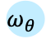
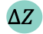



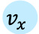



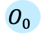
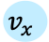
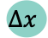


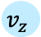


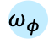
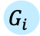

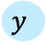
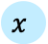
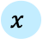
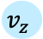
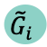
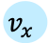


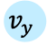
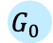
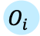

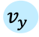

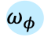
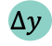



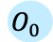


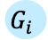

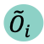
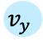
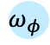
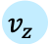
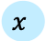
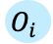

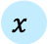

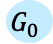
Well-tuned Action and Observation Space Enable Safe Flight With Disturbances
Two factors for designing effective observation and action space
Observation and action space transformation pipeline
Position
Velocity
Orientation
Body Rates
Gates
Obstacles
Simplify spaces as much as possible
→ Do not confuse learning
$$x$$
$$y$$
$$z$$
$$v_{x}$$
$$v_{y}$$
$$v_{z}$$
$$φ$$
$$θ$$
$$ψ$$
$$ω_{φ}$$
$$ω_{θ}$$
$$ω_{ψ}$$
$$G_{0}$$
$$G_{i}$$
$$…$$
$$O_{0}$$
$$O_{i}$$
$$…$$
1
Simplify Observation Space
1
$$x$$
$$y$$
$$z$$
$$v_{x}$$
$$v_{y}$$
$$v_{z}$$
$$φ$$
$$θ$$
$$ψ$$
$$ω_{φ}$$
$$ω_{θ}$$
$$ω_{ψ}$$
$$G_{0}$$
$$G_{i}$$
$$…$$
$$O_{0}$$
$$O_{i}$$
$$…$$
Translate to local frame
2
$$x$$
$$y$$
$$z$$
$$v_{x}$$
$$v_{y}$$
$$v_{z}$$
$$φ$$
$$θ$$
$$ω_{φ}$$
$$ω_{θ}$$
$${\tilde{G}}_{i}$$
$${\tilde{O}}_{i}$$
Policy Network
Provide gate and obstacle information in local frame
→ Globally generalizing behavior
$$Δx$$
$$Δy$$
$$ΔZ$$
2
De-normalize Action
2
$$x$$
$$y$$
$$z$$
Control Command
Global frame
Local frame
Notes:
The first key factor is to keep action and observation space as simple as possible, not confusing the drone with any unnecessary information. As shown on the right the observation space is implified by removing any yaw information from it, as yaw is not important for flying our drone and can just be always fixed to 0. Removing all obstacle and gates information except the current one provided further improvements. Before doing so when providing all gates the drone was unable to successfully identify the currently important gate and was therefore unable to react to gate changes. As a consequence, the drone just learned to overfit the static nominal scene providing good performance without disturbances but completely failed with them.
Providing gate and obstacle positions in the local frame of the drone, as well as giving drone actions as relative coordinate offsets is the second important factor. Relative coordinates are helpful, because like this all potential global constellations reduce to the difficulty of learning how to pass a gate based on its relative position.
(60 s)
(7 Minuten)

Slide 10
Experimental Results (Simulation)
Optimization and RL, twice as fast as baseline in static environment without disturbances
1
Result collection – Average lap times for different approaches [values collected over 100 runs]
Algorithm | Difficulty | Mean Time (s) | Success Rate (%)
Baseline | Static | 12.47 | 100
Baseline | Disturbed | 12.47 | 18
Optimization | Static | 6.50 | 86
RL | Static | 5.75 | 100
Optimization | Disturbed | 9.78 | 81
RL | Disturbed | 6.49 | 47
Baseline without re-planning fails in disturbed environment, only reaching success rate of 18%
2
Optimization most robust in disturbed environment, however tradeoff in lap time required to reach robustness
3
50% success rate in disturbed environments indicates RL agent learning to react to shifted gates
4
Notes:
After having shown you the key ideas and motivations behind both algorithm, the question is of course how do they compare in terms of lap time. For this what is reported here on the left side are the man lap times as well as the success rates of both my approaches and the baseline of Martin, all collected over 100 runs.
First focusing on the static environment without gate shift, both approaches demonstrate that they are capable of finding fast racing trajectories approximately doubling the performance of the initial baseline an passing the course in around 6.5 respectively 5.8 seconds.
Moving over to the disturbed environment, one can first clearly see how important adapting to gate changes is as the baseline without adaptations completely fails in this setting, achieving only a success rate of 18%.
The optimization approach on the other hand shows to be very robust even under these uncertainties reaching a success rate of 86%. However, to reach this robustness we unfortunately had to slow down the algorithm quite significantly to 9.8 secondswhich nevertheless is still an improvement in time over the static baseline.
Finally with the well designed state and action space also the RL agent manages to solve the disturbed environment quite successfully. While the success rate of around 50% definitely leaves room for future improvements it is significantly better than the 18% of the baseline thus indicating that our algorithm is in fact learning to react to gate changes without even incurring a significant drop in mean lap time
(1:40)

Slide 11
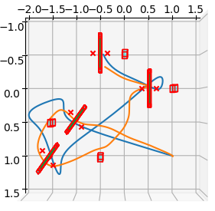
Three Factors Enable RL to Outperform Optimization in Lap-Time
Flight trajectories: Optimization (blue) vs. Reinforcement Learning (orange)
Three factors explain how the RL agent can outperform optimization in lap-time
Missing controllability due to onboard controller indirection cause overshoots
1
1
3
Shortest path length criterion introduces sharp turns reducing speed and amplifying overshoots
2
Padding around obstacles required to guarantee robustness increases path length
2
3
Original Path
Optimization
Reinforcement Learning
Notes:
Going more into detail and comparing the flight paths of the optimization approach here in blue and the RL in orange, I identify three ways how the RL agent manages to outperform the Optimization in terms of lap time.
First, missing controllability of the drone due to the indirection with an additional onboard controller means that the optimization algorithm often overshoots the pre-planned path. This can be seen at 1 where both approaches want to stop in the gate, however, the optimization approach completely overshoots. The RL agent does not suffer from the same issue because it learns the system model including the onboard controller.
Overshoots are further amplified by the path-length optimization criterion that commonly introduces sharp turns. This can be seen here in 2, where we see how the path overshoots the violet original shortest path. A different optimization criterion could prevent these cases by slightly increasing path-length therefore preventing overshoots while allowing higher path velocities causing overall faster lap times.
Finally, to allow safe flight, even with those overshoots I had to introduce extra inflation radia around obstacles. As shown at three this padding unncesearily increases the path length compared to the RL drone.

Slide 12
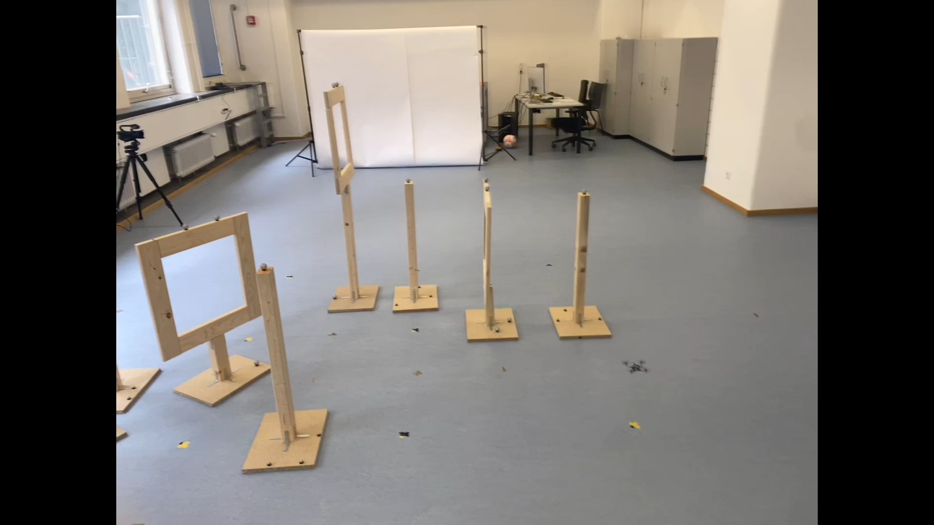
Sim2Real Transfer – Optimization Based Drone Control
Optimization approach successfully transferred to real world (video)
1
No time to transfer RL approach. Experiences of other groups indicate challenges
2
Notes:
In addition to simulation I was succesfuly able to transfer my optimization approach to the real world as it is shown here on the left.
Unfortunately, due to missing time, I was not able to also transfer by RL algorithm to real world. However, the difficulties of ther groups indicate that this might be challenging
(30 – 40 s)

Slide 13
Milestones and Key Results
Milestones
Key Results
Initial Goals
Achieved optimization-based drone racing with re-planning by focusing on computational efficient multithreaded C++ implementation
Reached fast lap times in static environment and high robustness to disturbances
Future work: Include obstacle updates
1
Implement optimization-based drone racing with re-plan capabilities
2
Apply algorithm to real-drone outperforming original baseline
3
Develop fast RL agent for static environment
Solved static environment with 100% success rates and fast lap times
Tuning observation and action space enabled flying in dynamic environment
Future work: Further improve robustness and Sim2Real transfer
4
Develop fast RL agent for disturbed environment
5
Sim2Real transfer RL agent
Achieved
Partially Achieved
Not Achieved
Notes:
Let me finally conclude the presentation by comparing my initial milestones with the progress and key results I did in all of them
As I am alone my initial goals for this project were only to implement a fast optimization-based drone racing pipeline with re-planning capabilities. By focusing on high-computational efficiency, I was able to complete this milestone outperforming the baseline in the static environment by a factor of 2 and providing high robustness to gate shifts.
Due to fast progress with the initial 2 milestones, I then decided to also work on the RL agent. For the limited time I think I also did good progress there designing a 100% successful approach achieving the fastest lap-times of all tested approaches in the static environment. While I was uncertain in the beginning whether the RL agent can handle the gate shifts, I was also able to implement a decent performing algorithm there as well.
However, there is still future work to be done. For the optimization approach, some further improvements are achievable by also including obstacle and not just gate updates. For the RL agent the main future works are working on the Sim2Real Transfer and improving robustness in the disturbed environment.
Thank you very much
(75s)

Slide 14
Sources
“Ompl::Geometric::RRTstar Class Reference.” Accessed July 6, 2024. https://ompl.kavrakilab.org/classompl_1_1geometric_1_1RRTstar.html.
Kunz, Tobias, and Mike Stilman. “Time-Optimal Trajectory Generation for Path Following with Bounded Acceleration and Velocity.” In Robotics, edited by Nicholas Roy, Paul Newman, and Siddhartha Srinivasa, 209–16. The MIT Press, 2013. https://doi.org/10.7551/mitpress/9816.003.0032.
“Champion-Level Drone Racing Using Deep Reinforcement Learning | Nature.” Accessed April 23, 2024. https://www.nature.com/articles/s41586-023-06419-4.
Song, Yunlong, Mats Steinweg, Elia Kaufmann, and Davide Scaramuzza. “Autonomous Drone Racing with Deep Reinforcement Learning.” In 2021 IEEE/RSJ International Conference on Intelligent Robots and Systems (IROS), 1205–12. Prague, Czech Republic: IEEE, 2021. https://doi.org/10.1109/IROS51168.2021.9636053.

Slide 15
Appendix
Autonomous Drone Racing - Final Presentation
17.07.2024
Tim Lindenau

Slide 16
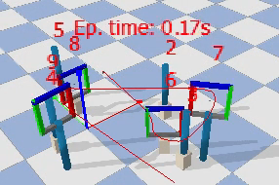
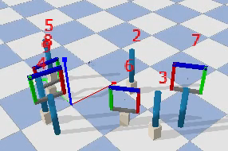
Visualization in Simulation (With Disturbances)
Approach 1: Optimization
Approach 2: Reinforcement Learning
Notes:
Of course just reporting the numbers is a bit abstract, so on this slide I am also showing you both algorithms in action
Lets start with the optimization based approach, where one can see well how the initial trajectory based on nominal gate position is invalid and would collide with the first gate. If we now start the simulation, we see that as soon as the drone moves towards the first gate and gets a position update the trajectory is re-computed thus, allowing the drone to successfully pass this gate.
Switching over to the RL agent, it is also able to sucesfully pass the disturbed track, in total taking only around 6 seconds.
(40s)

Slide 17
Reinforcement Learning: Reward Function
Key Requirements For Effective Reward Function
Path progress provides dense proxy reward for minimizing lap times
Lap time reward immediately rewards fast lap time, however reward sparse only at end of successful episodes
Per-time-step progress towards next goal, good proxy reward, providing dense supervision at each time step
1
Alignment with goal of drone racing, i.e., finishing track in minimum time
$$r_{prog}\left(t\right)={\left\|x\left(t−1\right)−g\right\|}_{2}−{\left\|x\left(t\right)−g\right\|}_{2}$$
2
Dense supervision at each time-step to simplify information gain of learning algorithm
Total reward function completed with binary gate-pass, and collision reward
$$r\left(t\right)=λ_{prog}r_{prog}\left(t\right)+λ_{gate} r_{gate}\left(t\right)+λ_{col} r_{col}\left(t\right)$$
Notes:
First focusing on the reward function, there are generally two requirements an efficient reward function must fulfill. It should align well with the overall optimization objective, meaning drone racing, and it should provide dense supervision at each time step to simplify the information gain of the learning algorithm. To fulfil the first requirement the most natural choice for drone-racing would probably be just taking the time it take the drone to complete a lap as reward. Unfortunately, this reward function does not work well as it is very sparse and only provides supervision at the end of a successful episode. Therefore, to increase the level of supervision we utilized the progress towards the next goal as reward, this being a good proxy for minimizing racing time, while providing learning supervision at each time step. The general calculation of this reward is shown below, where we basically just subtract the distance of the drone to next gate in the current time step, from the distance in the previous one.
With progress as the main reward, the overyll reward function is completex by adding a positive binary reward whenever passing a gate as well as a punishment for colliding.
(60s)

